Slide 1
Resources to help your child be successful in school
Homework help for the busy parent

Slide 2
Disclaimer
All of the sites shown here offer free resources. Some of the sites also have a paid section. This is not an endorsement of the paid section of those sites. Most of the resources in the paid section can be found on other free sites.

Slide 3
General Homework Help Sites

Slide 4
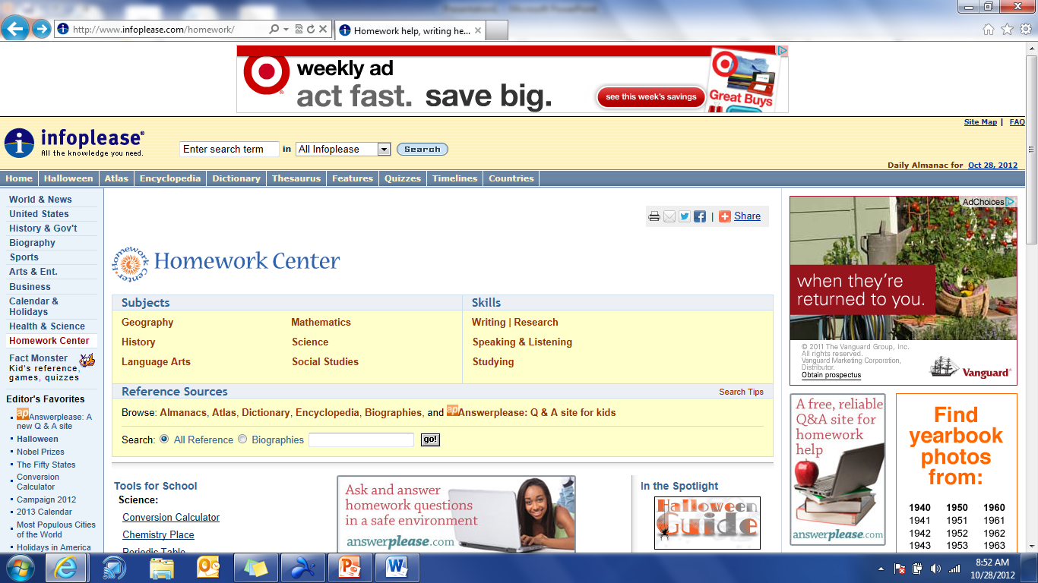
http://www.infoplease.com/homework/

Slide 5
http://www.factmonster.com/

Slide 6
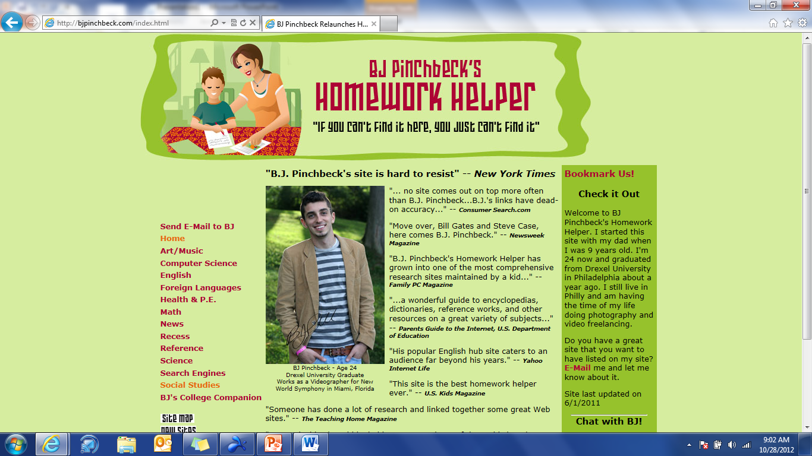
http://bjpinchbeck.com/index.html

Slide 7
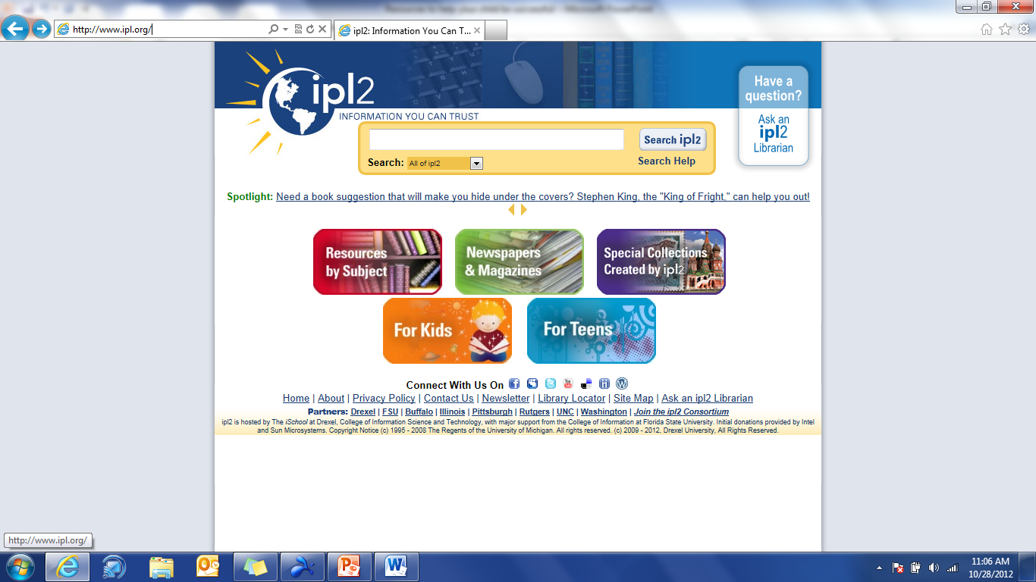
http://www.ipl.org/

Slide 8
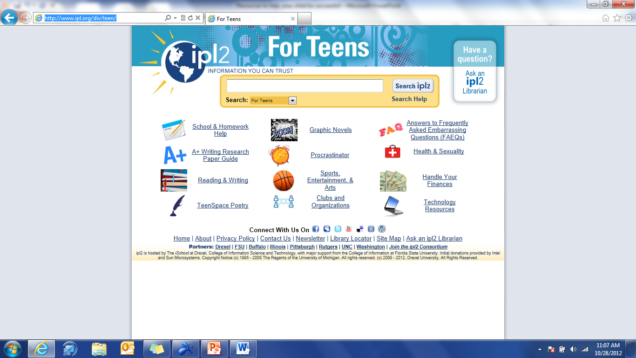
http://www.ipl.org/div/teen/

Slide 9
Social Studies Sites

Slide 10
http://www.mrdowling.com/

Slide 11
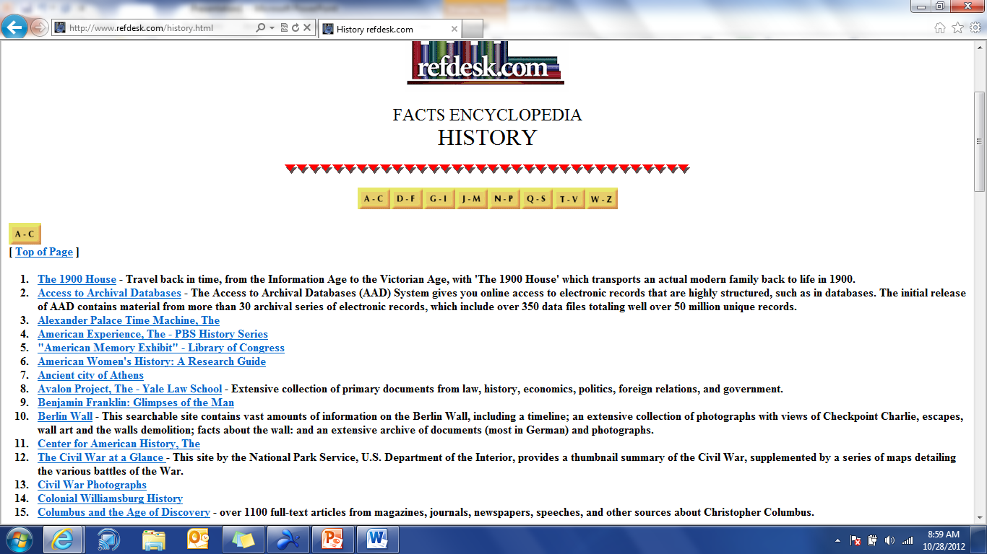
http://www.refdesk.com/history.html

Slide 12
English, Reading, Writing, Language Arts

Slide 13
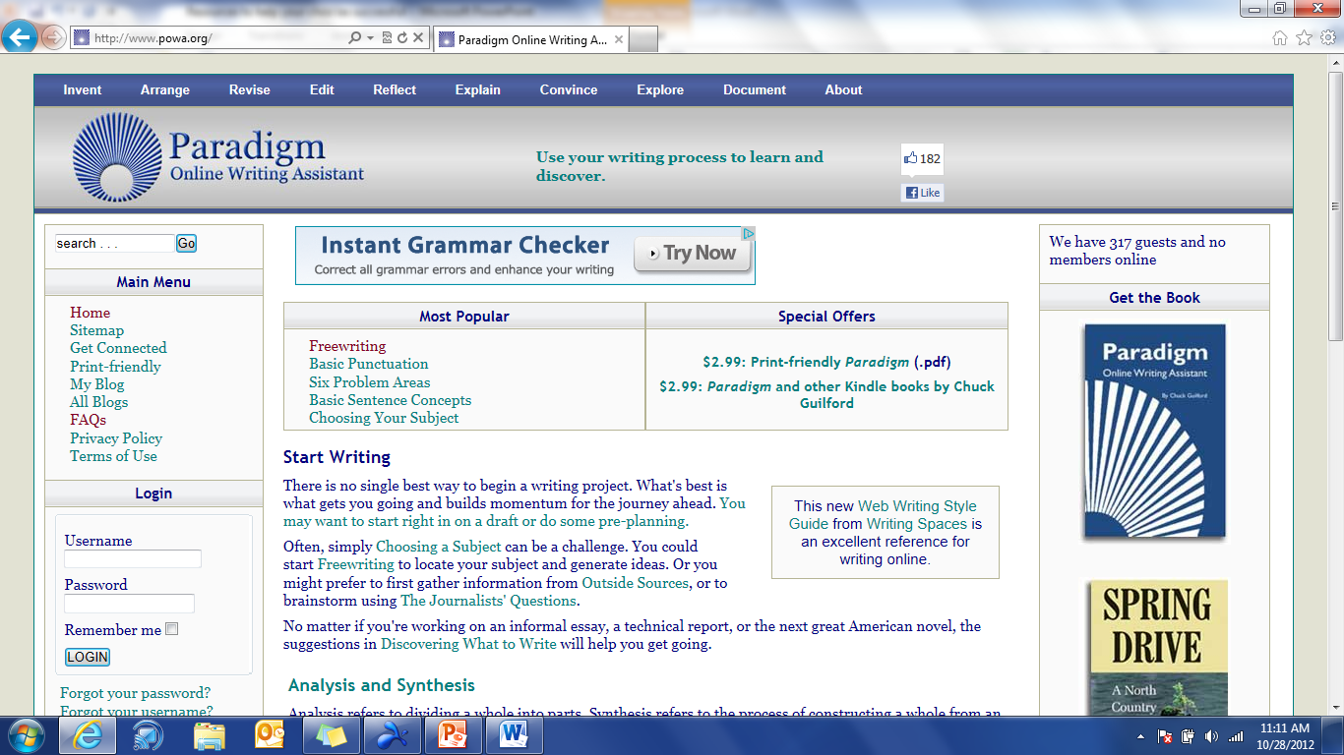
http://www.powa.org/

Slide 14
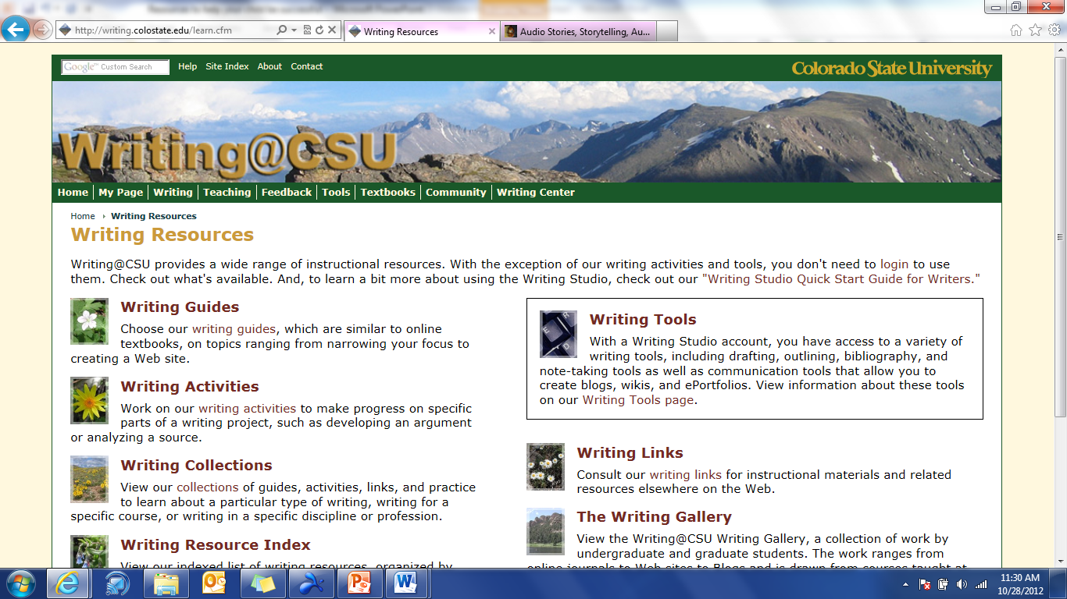
http://writing.colostate.edu/learn.cfm

Slide 15
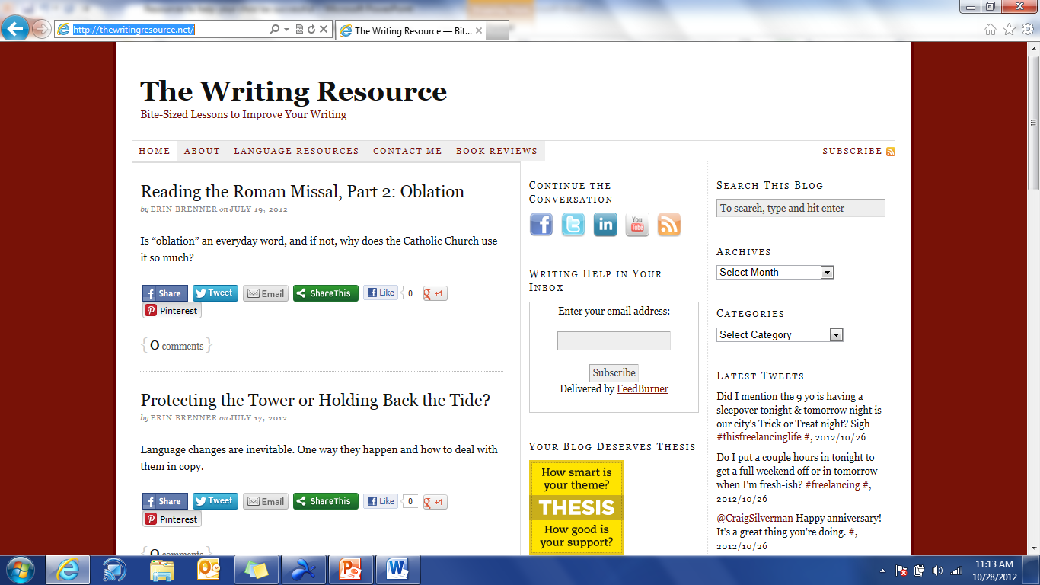
http://thewritingresource.net/

Slide 16
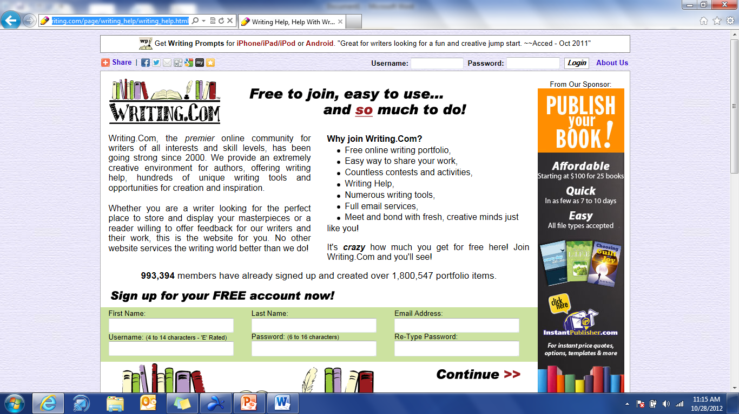
http://www.writing.com/page/writing_help/writing_help.html

Slide 17
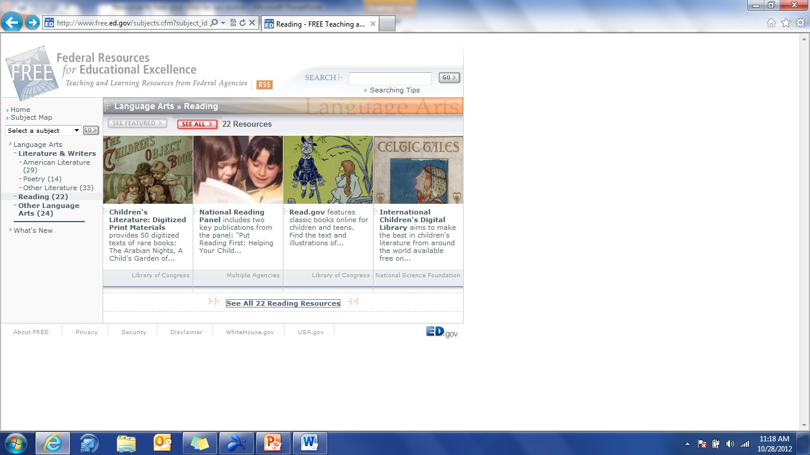
http://www.free.ed.gov/subjects.cfm?subject_id=80&toplvl=78

Slide 18
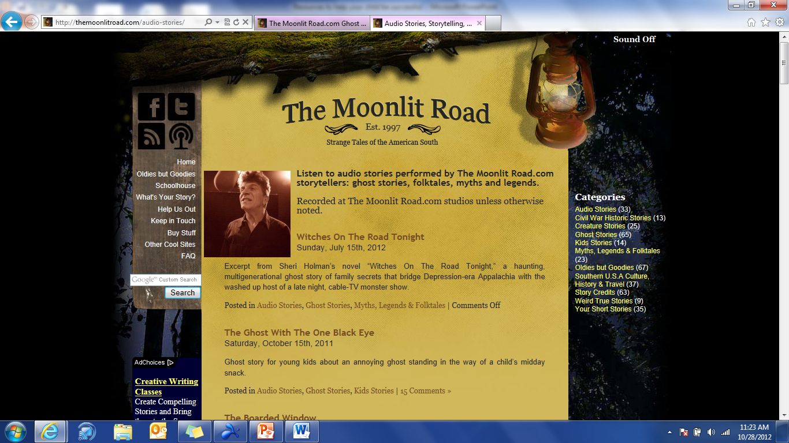
http://themoonlitroad.com/audio-stories/

Slide 19
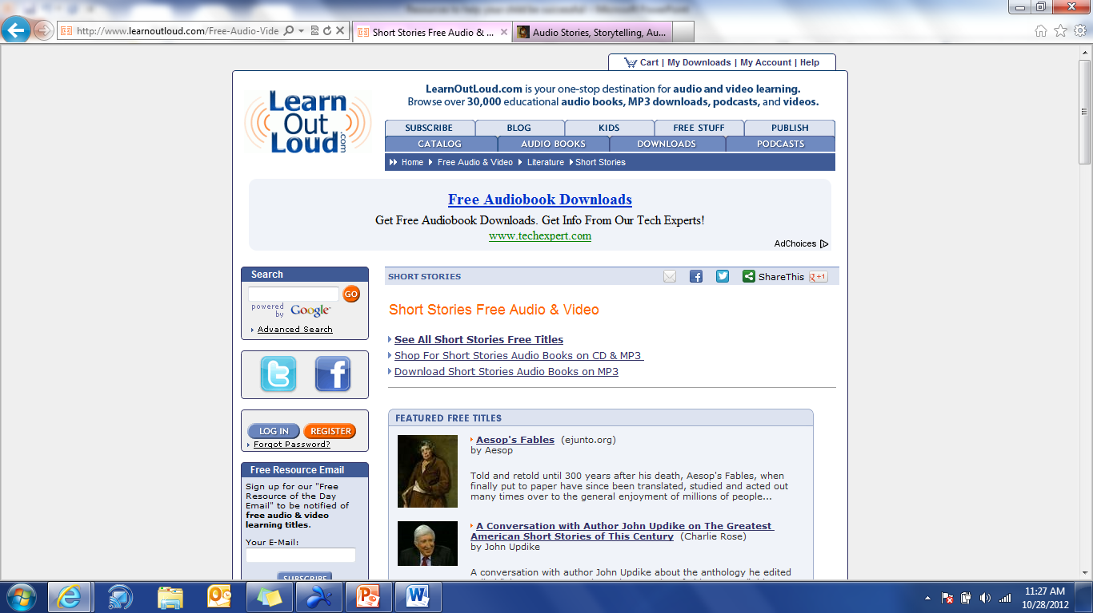
http://www.learnoutloud.com/Free-Audio-Video/Literature/Short-Stories

Slide 20
Science Resources

Slide 21
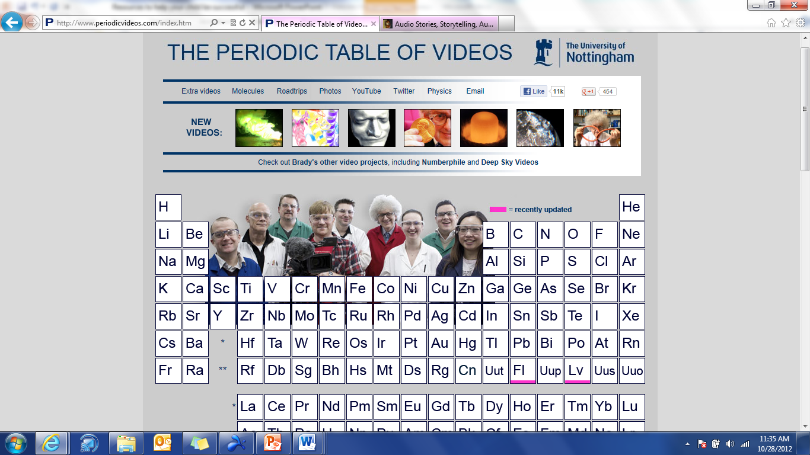
http://www.periodicvideos.com/index.htm

Slide 22
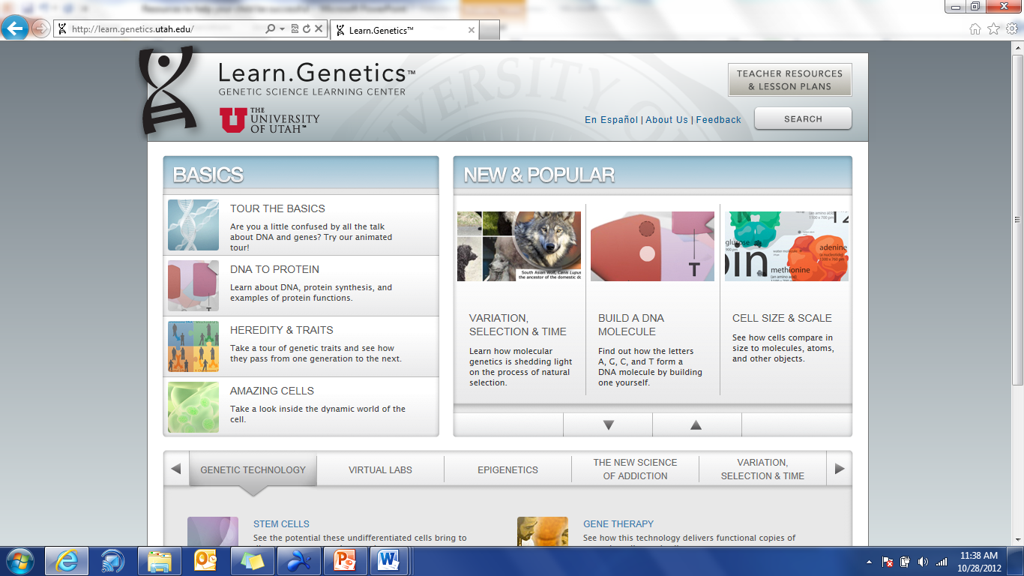
http://learn.genetics.utah.edu/

Slide 23
Math Resources

Slide 24
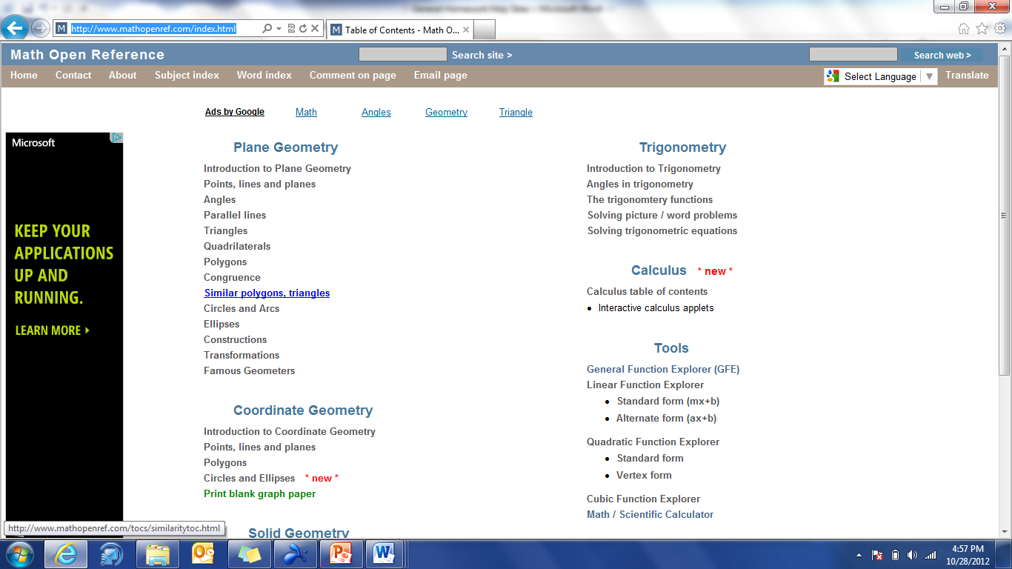
http://www.mathopenref.com/index.html

Slide 25
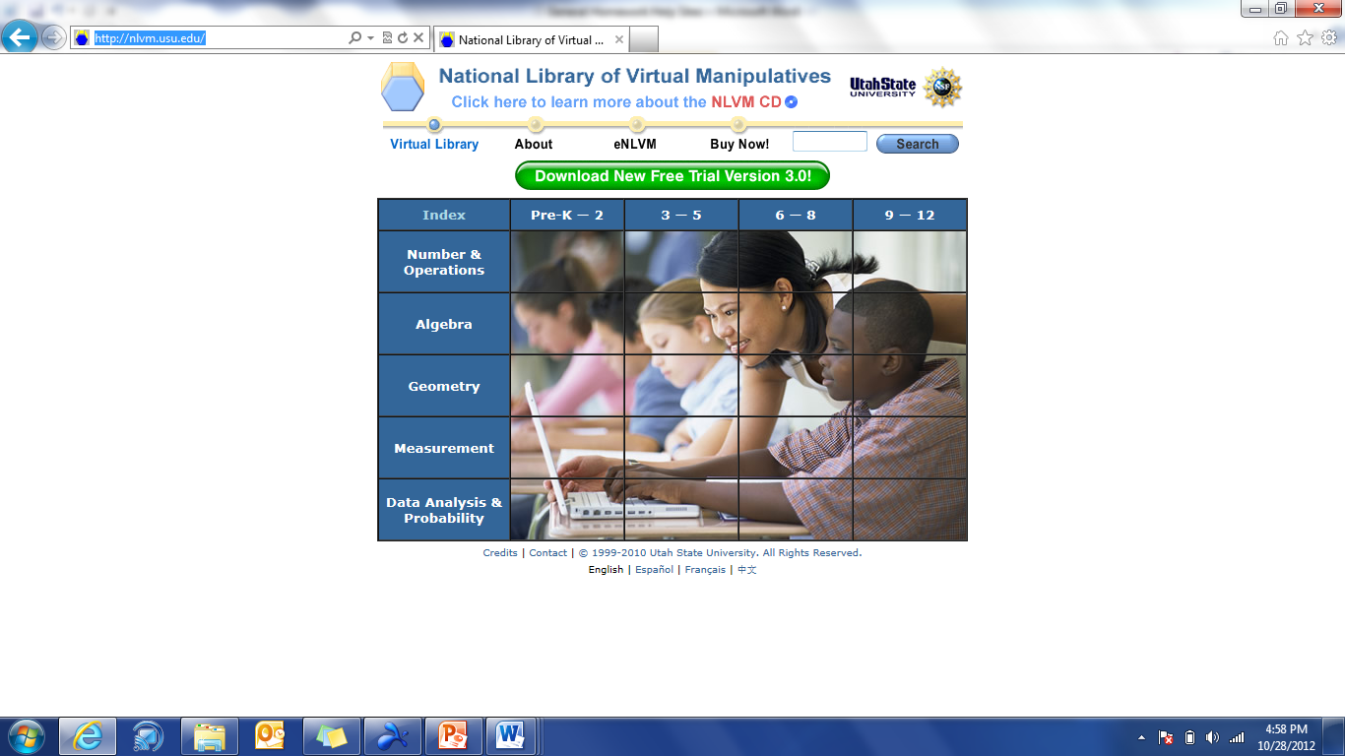
http://nlvm.usu.edu/

Slide 26
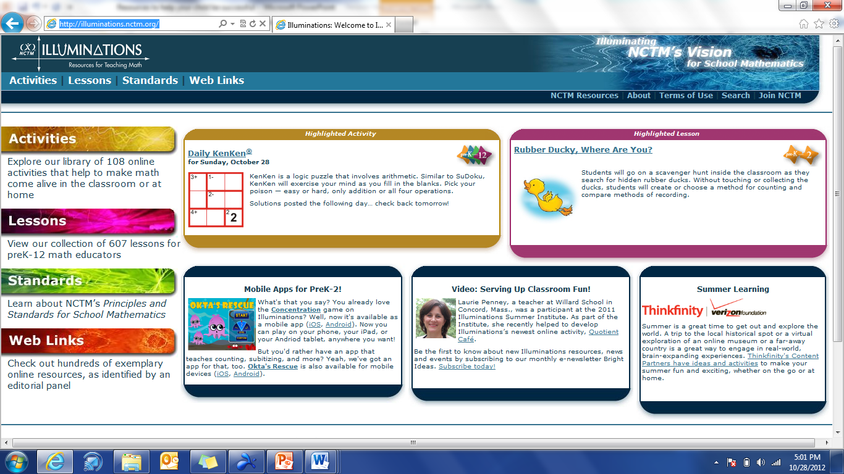
http://illuminations.nctm.org/

Slide 27
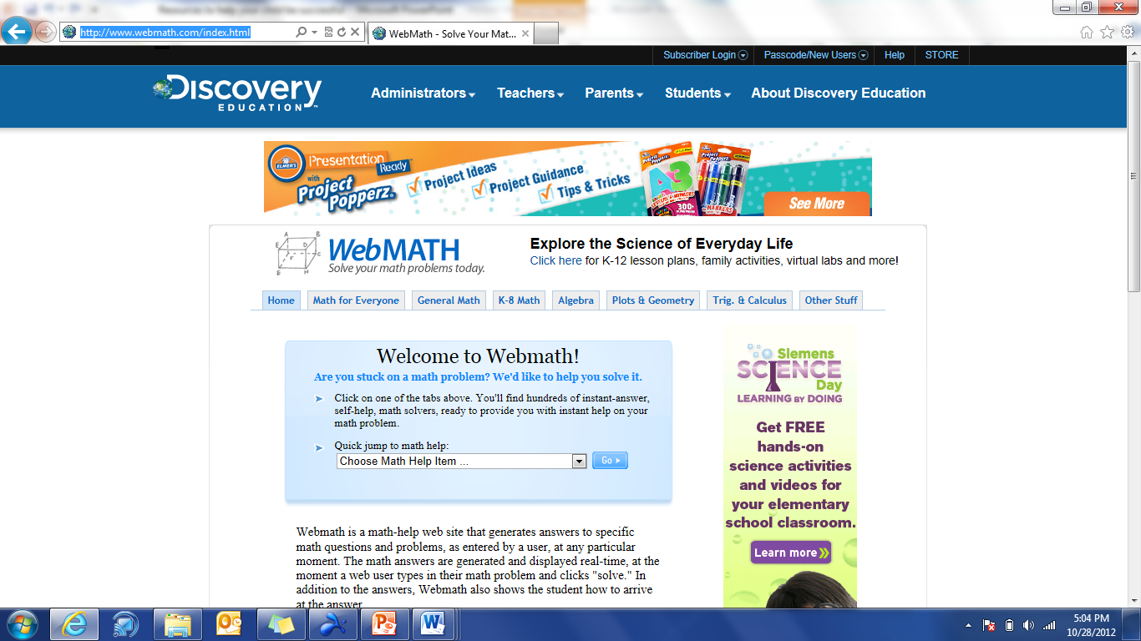
http://www.webmath.com/index.html

Slide 28
Free tools

Slide 29
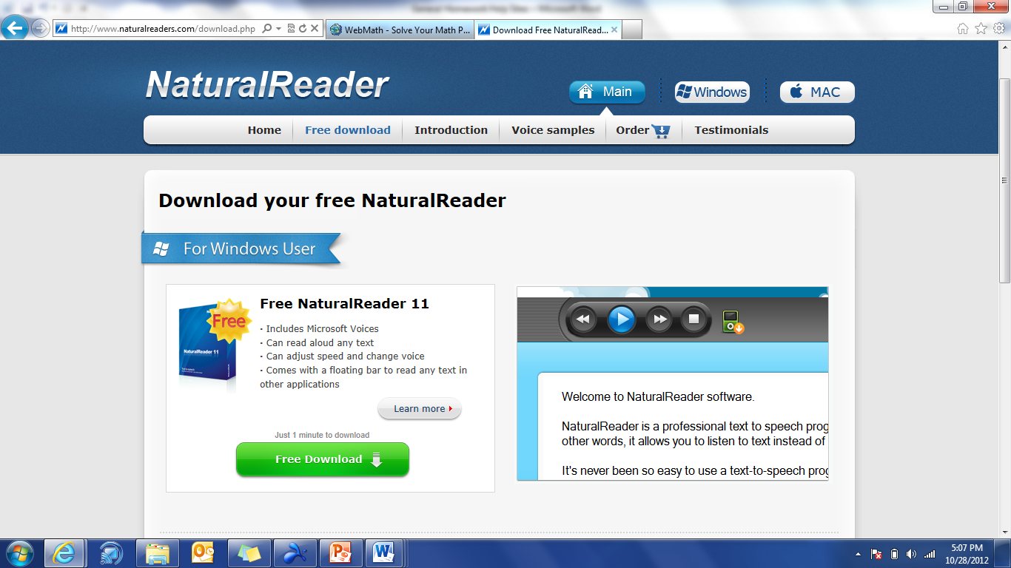
Free text to speech app http://www.naturalreaders.com/download.php

Slide 30
Please contact me
Please contact me if you have any questions or need more resources:
edo@bath.k12.va.us

